Slide 1
Save on Tuition with WUE
Discover your options in the West!

Slide 2
CONSIDERING AN OUT-OF-STATE COLLEGE?
Let WUE help you save money on tuition!

Slide 3

What is WUE?
America’s largest regional interstate tuition savings program
The Western Undergraduate Exchange (WUE) is an agreement among WICHE’s 16 member states and territories, through which 160+ participating public colleges and universities provide steep nonresident tuition savings for Western students.

Slide 4
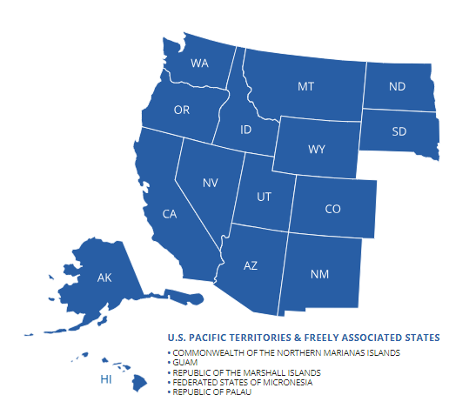
Eligible States and Territories

Slide 5
How Much is WUE Tuition?
WUE is 150% of the enrolling school’s resident tuition (sometimes less!)
Examples of 2022-23 WUE Tuition Rates
 | In-State Tuition | Non-Resident Tuition | WUE Tuition (resident * 1.5) | Savings
Eastern Washington University | $7,193 | $24,894 | $10,790 | $14,104
Dawson Community College (MT) | $2,520 | $6,930 | $3,780 | $3,150

Slide 6

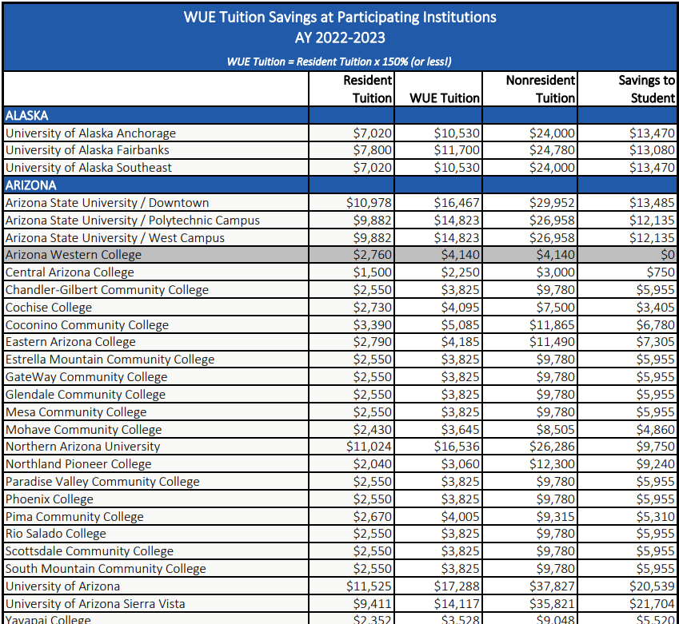
https://www.wiche.edu/resources/wue-savings-chart/
NOTE: Savings estimates based on standard programs. Special program tuition may be higher (i.e., engineering, nursing, etc.)

Slide 7
AY 2022-23
46,110
WUE Students
$521 M
In Out-of-State Tuition Savings
$11,294
Average Savings per Student

Slide 8
Roadmap
Determine if a separate application is required
Be a resident of a WICHE state or Pacific island jurisdiction
Check to see if the desired major is eligible
1
3
5
2
4
6
Apply directly to the college
Search for colleges on the WUE Savings Finder
Check application deadlines and/or minimum requirements. WUE is not guaranteed; you must qualify
https://www.wiche.edu/tuition-savings/wue/

Slide 9
Things to Know
Institutions set their own requirements for earning the WUE rate
Remain in good academic standing to keep your WUE rate
Can’t establish residency while on WUE

Slide 10
Where are the WUE Schools?
Our 160+ two- and four-year schools are located throughout the WICHE region.

Slide 11

Use the WUE Savings Finder for the Complete List of WUE schools

Slide 12
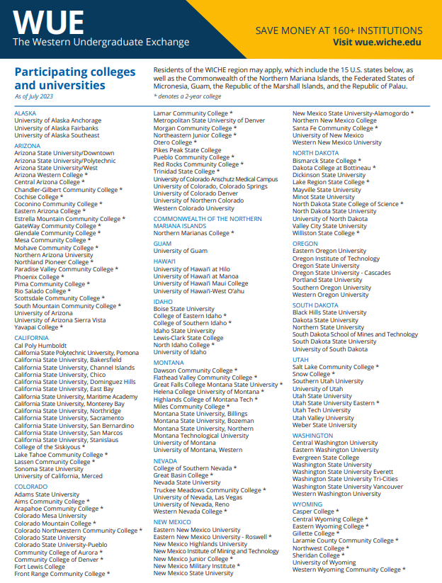

Or download the WUE Handout
https://www.wiche.edu/resources/wue-handout/

Slide 13
Often requested, but don’t participate (or limited)
Don’t participate in WUE:
Limited options:
Arizona State University, Tempe (main campus)
  NOTE: ASU’s Downtown, Polytechnic and West campuses
  DO participate in WUE.
Colorado School of Mines
University of Colorado Boulder
University of Oregon
University of Washington
University of Arizona, Tucson; only two majors at the WUE rate:
  Mining Engineering and Natural Resources

Slide 14
Questions about WUE?
The schools are your best resource!
Visit https://www.wiche.edu/tuition-savings/wue/wue-savings-finder/
Check the school’s website for information
Contact the school’s financial aid/scholarship/or admissions departments directly
If you still have questions after speaking with them, contact WICHE at:
TEL: 303.541.0270
info-sap@wiche.edu

